Slide 1
Azure Active Directory Roadmap
Advanced Security - MCAS & Azure Sentinel
Enabling Centralised Monitoring & Alerting & Do Cost Analysis
Enable Azure Sentinel for incident management and Implement MCAS for the CASB Solution
Enable Monitoring through Azure
Log analytics workspaces & Create
Correlation rules
CSPM - Continous Posture Assessment
Reconsilation
Remidiating the
Observations
Talk to business teams
And discuss the remediation
Steps
Create a Policy to Monitor the Config
Auditing
Tenants against Baseline
Audit Each B2C Tenant and Provide Gap analysis Reports
Creating Baseline & Policy
This is the common Baseline that Applies to every B2B/B2C Tenant in Azure

Slide 2
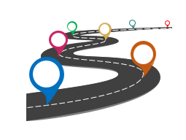
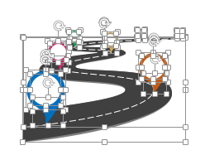
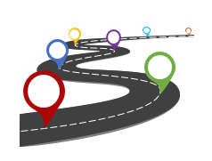
All images are 100% editable in PowerPoint
“Change color, size and orientation of any icon to your liking”

Slide 3
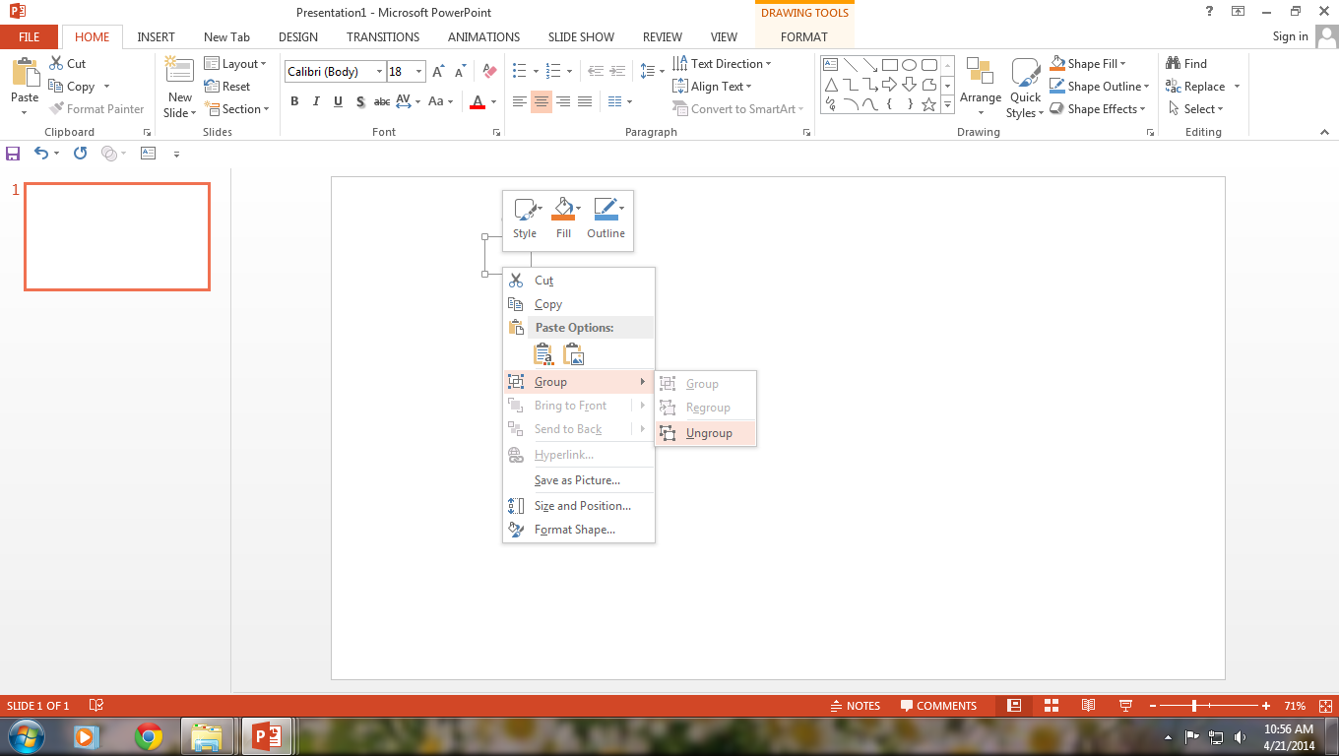
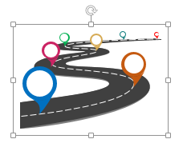
Ungrouping the object
2
1
3
Right click the object.
Choose Group and then Ungroup.
Click beside the object and drag the arrow over it.

Slide 4
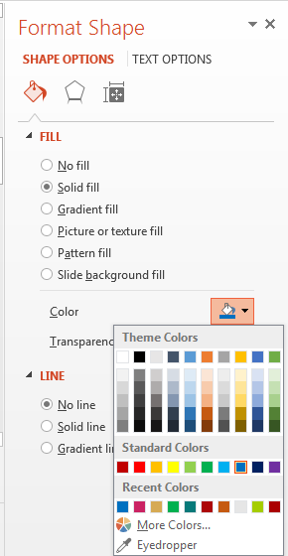
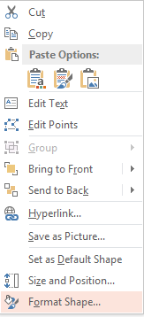

Edit Color
3
2
1
Select the shape to change the color and Right click the object( click any object which you want to change color)
Choose Format Shape in the dialog box.
Choose “Fill” in the Format Shape box then “Solid” or “Gradient” depending on the appearance of the object. Change colour as shown in the picture.

